Slide 2
Diamonds
Mariea Deshommes, Nichelle Nesbitt, Audrey Bouldin

Slide 3
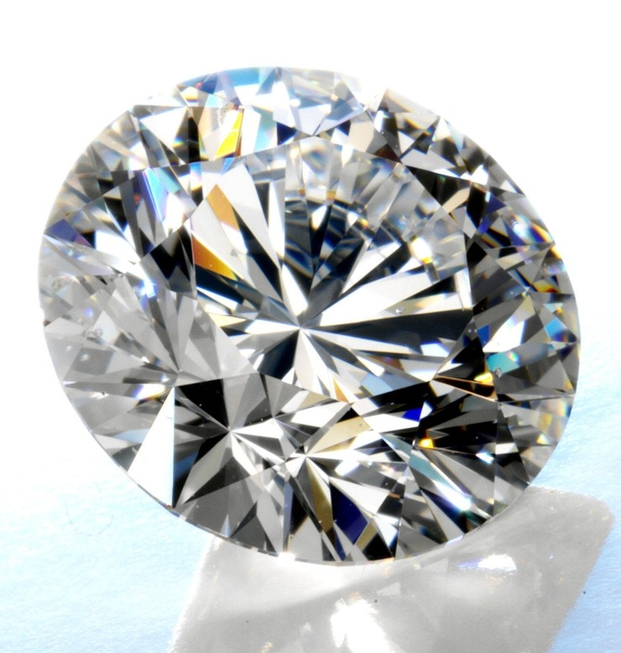
Project Final Criteria
De-Mystifying ML
Find a Problem worth Solving, Analyzing, or Visualizing
Use ML in the context of technologies learned
You must use:
Sci-Kit Learn and/or another machine learning library
You must use at least two of the below
Python Pandas
Python Matplotlib
Python Tweepy
Python Flask
HTML/CSS/Bootstrap
JavaScript Plotly
Javascript D3.js
JavaScript Leaflet
MySQL Database
MongoDB Database
Google Cloud SQL
Amazon AWS
Tableau

Slide 4
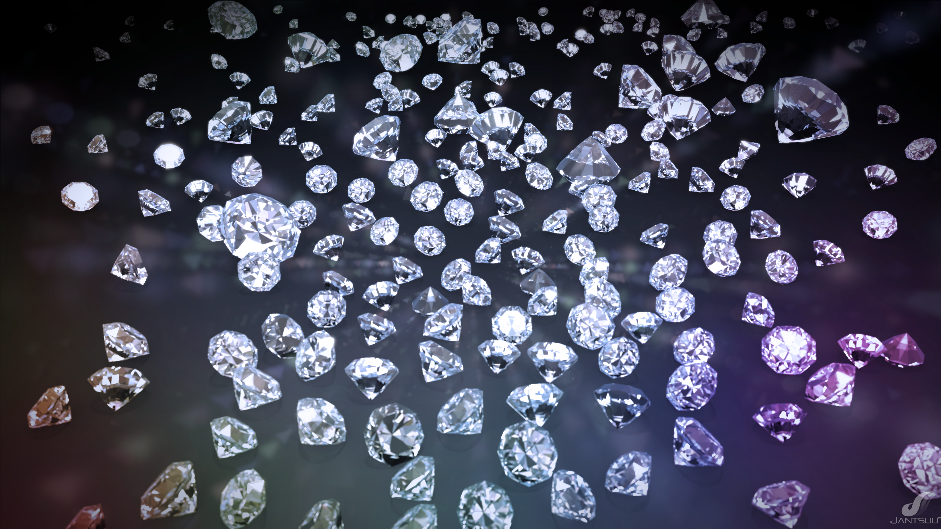
Goal
To classify diamond prices using Linear Regression, Random Forrest
Diamond is a solid form of pure carbon with its atoms arranged in a crystal.
The most familiar uses of diamonds today are as gemstones used for adornment, and as industrial abrasives for cutting hard materials. The markets for gem-grade and industrial-grade diamonds value diamonds differently.
Source: https://en.wikipedia.org/wiki/Diamond
This Photo by Unknown Author is licensed under CC BY

Slide 5
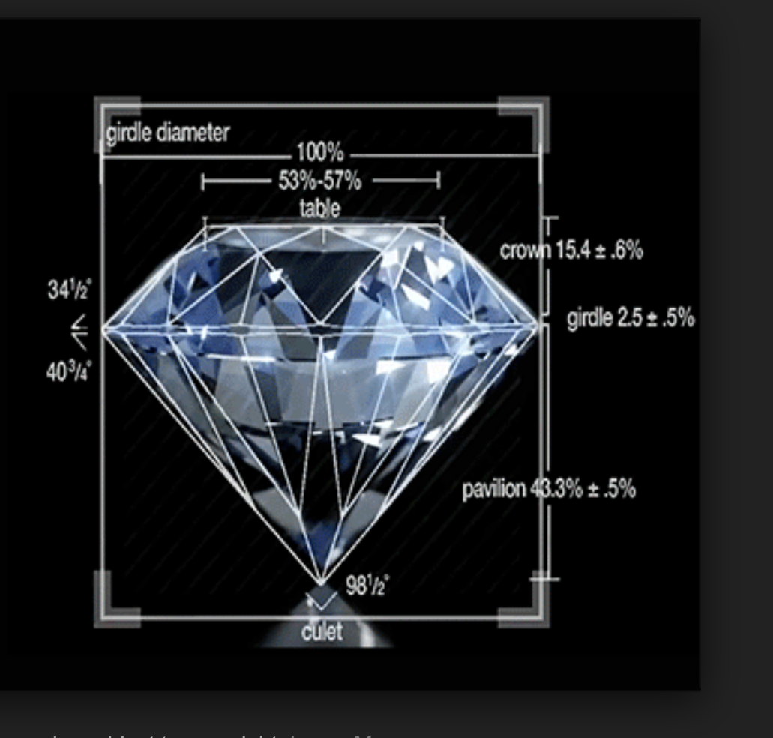
Diamond Features
Carat = Carat weight of the diamond
Cut = Describe cut quality of the diamond. Quality in increasing order Fair, Good, Very Good, Premium, Ideal
Color = Color of the diamond, with D being the best and J the worst
Clarity = How obvious inclusions are within the diamond:(in order from best to worst, FL = flawless, I3= level 3 inclusions) FL,IF, VVS1, VVS2, VS1, VS2, SI1, SI2, I1, I2, I3
Depth = depth % :The height of a diamond, measured from the culet to the table, divided by its average girdle diameter
Table = table%: The width of the diamond's table expressed as a percentage of its average diameter
X = length mm
Y = width mm
Z = depth mm

Slide 6
ETL Process
Step 1 Extract
Download data from Kaggle
Step 2 Transpose
Step 3 Load
Visual Studio Code
Quantify Columns

Slide 7
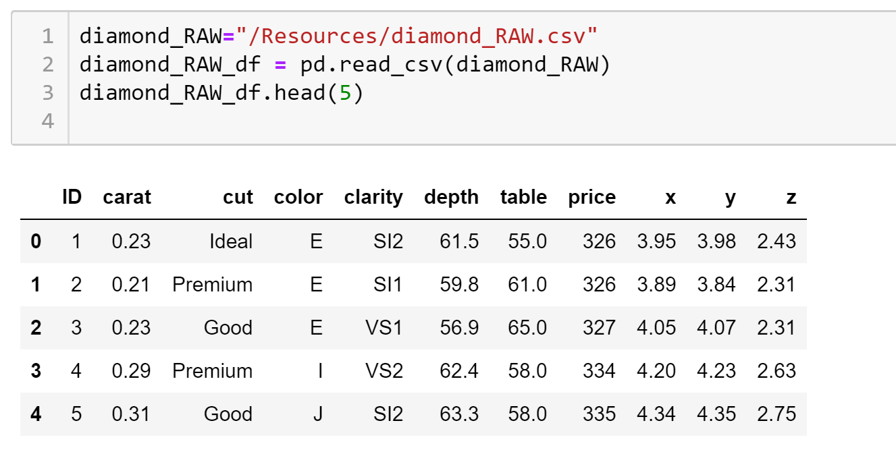
EXTRACTING
(quantitative specifics
shown below):
A data frame with 53940 rows and 10 variables
Price price in US dollars (\$326--\$18,823)
carat weight of the diamond (0.2--5.01)
x length in mm (0--10.74)
y width in mm (0--58.9)
z depth in mm (0--31.8)
depth total depth percentage = z / mean(x, y) = 2 * z / (x + y) (43--79)
table width of top of diamond relative to widest point (43--95)
https://www.kaggle.com/shivam2503/diamonds

Slide 8
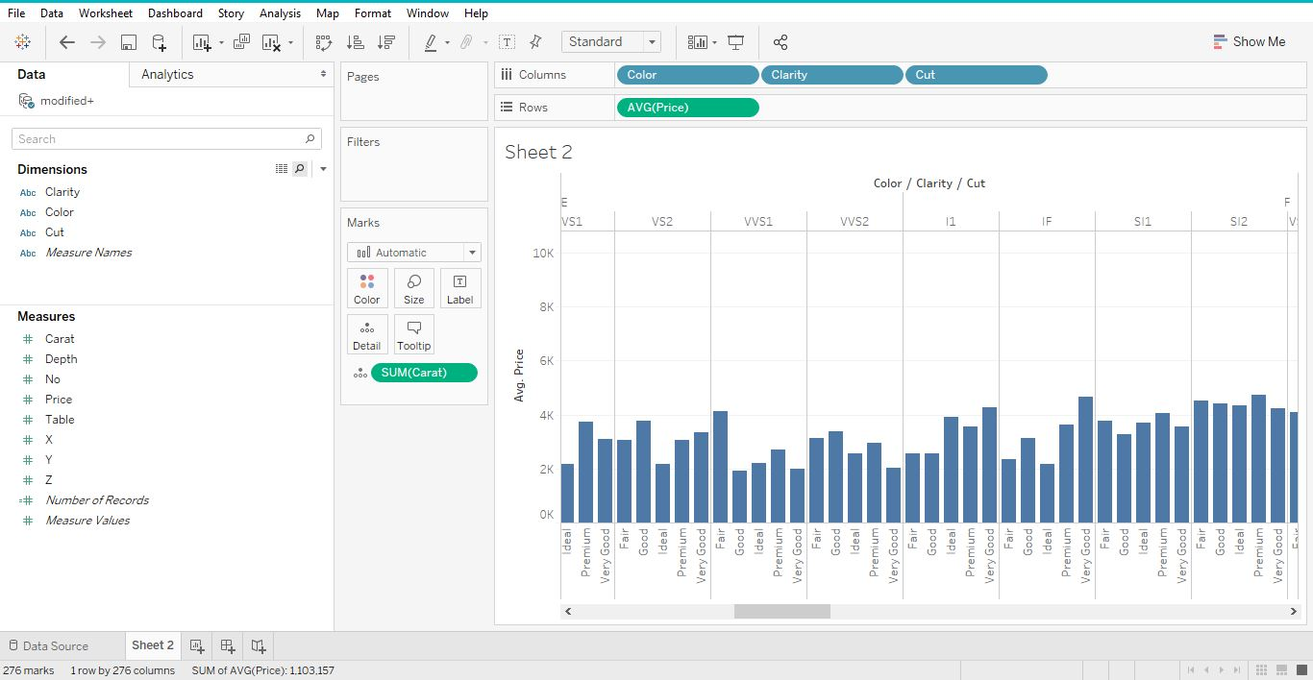
Graph of Cut, Color, and Clarity

Slide 9
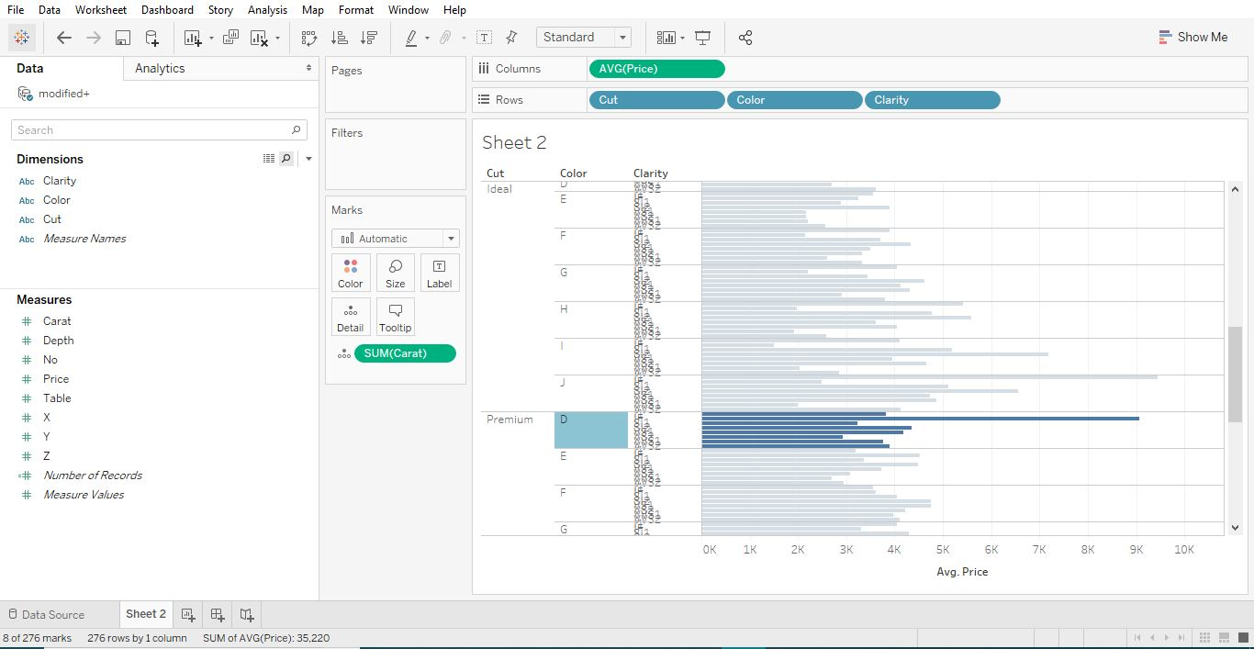

Slide 10
TRANSPOSE
Dropped ID
Gave numerical value
Cut 1 to 5
Color 1 to 7
Clarity 1 to 8
Removed samples with zero values

Slide 11
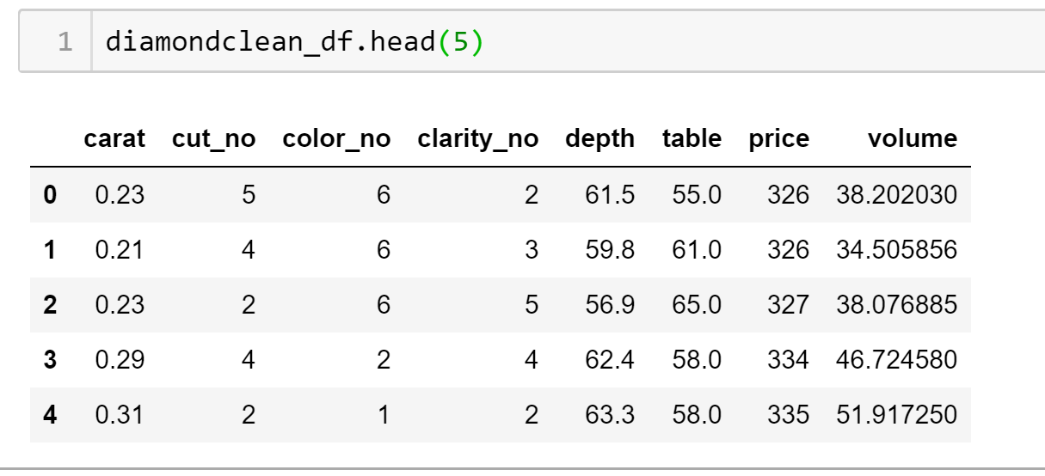
LOAD

Slide 12
Machine Learning

Slide 13
CLASSIFICATION ALGORITHMS w/ Python
Data on Trained Model
Data on Predicted model
Accuracy
Show code/graphs

Slide 14
Machine Learning
First bullet point here
Second bullet point here
Third bullet point here
Class | Group 1 | Group 2
Class 1 | 82 | 95
Class 2 | 76 | 88
Class 3 | 84 | 90

Slide 15
Predicting Diamond Prices

Slide 16
Predicting Data with unknown
Data on Trained Model
Data on Predicted model
Accuracy
Show code/graphs

Slide 17
Sample Vs Predicted Diamond Prices

